Slide 1

Taylor’s Professional Service E-Commerce Web Site
Team C
Jeremy Adams
Taunyl Bailey
Tim Olson
Rachel Spiegelhoff
CIS-470 Senior Project – August 2014

Slide 2
Project Background
Taylor’s Professional Services (TPS) is a Technical and Engineering staffing service.
If one of Taylor Professional Services client companies determines the need for a temporary, professional or scientific employee, a request is submitted according to a contract that the client company previously negotiated with (TPS).
Taylor Professional Services wanted to provide a website so that their clients can complete a staffing request over the Internet.
Speaker: Tim Olson

Slide 3
Project Background
Also, Taylor Professional Services staff members will be able to update their resumes and pictures through the website.
In addition, Taylor Professional Services wanted to provide their clients with a list of potential candidates. This prospect list included potential candidate experience, potential candidate education, potential candidate salary, and potential candidate location.
The Taylor Professional Services client will be able to select three future staff members along with the location of work, type of work, and salary. Then it will allow them to submit the request to the contract manager. Once the request is submitted, the web-based system shall provide an automated response stating that the contract manager will validate their request within 24 hours of receipt.
Speaker: Tim Olson

Slide 4
Project Description
Wants the staffing request has been received and then issued, Taylor Professional Services client will be able to log into the site and search for a staff request by number. This number will coincide with a request query that results in a page that contains all staff request information along with a field that states whether the staff request is valid, invalid, unable to fill, or filled.
In addition, the web site has a layout that is easy to use. The interface is designed to allow log in based on credentials and these credentials will then determine what the log in has access to. The access levels will then allow the log in either to retrieve information, insert new information, delete information or edit information.
Speaker: Tim Olson

Slide 5
Project Background
There are three areas to the website:
Only clients with a valid contract numbers and password are able to enter the client area.
Only staff members with a valid employee numbers and password will be able to enter the staff area.
Only the contract manager has full access to both locations.
Speaker: Tim Olson

Slide 6
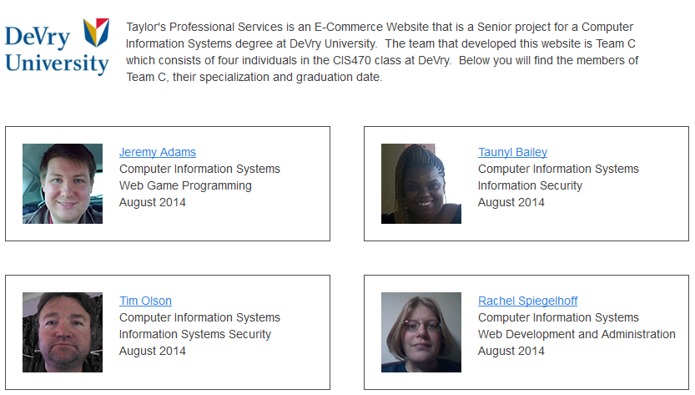
Team C
Speaker: Tim Olson

Slide 7

Requirements & Analysis Overview
Project Requirements
Website for clients to complete staffing request online
Listing of potential candidates to select from
Ability to search for staff request
Staff members update resume and pictures online
Site divided into 3 parts:
Staff
Client
Manager
Speaker: Rachel Spiegelhoff

Slide 8
Requirements & Analysis Overview
Process Analyzed
Creation, modification storage and retrieval of:
Staffing request information
Contract information
Staff Information
And User access information
Staffing Request
Client enter and retrieve
Contract Manager retrieves, validates and closes out
Staff
Update personal information, resume, availability and picture
Speaker: Rachel Spiegelhoff

Slide 9
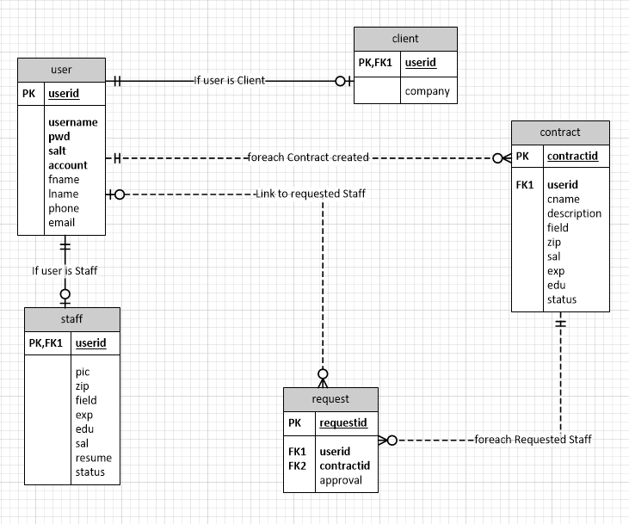
Requirements & Analysis Overview
ERD
Speaker: Rachel Spiegelhoff

Slide 10
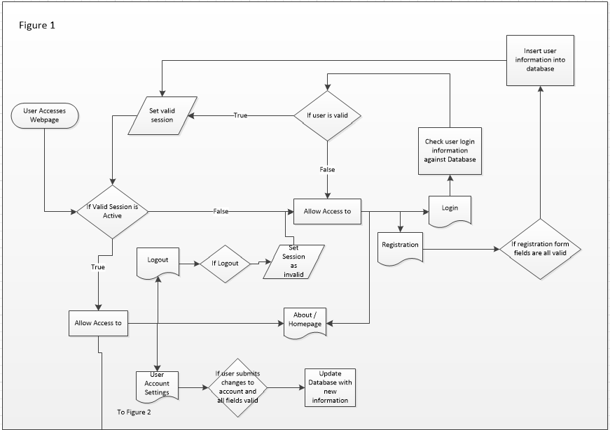
Requirements & Analysis Overview
Process Flow
Speaker: Rachel Spiegelhoff

Slide 11
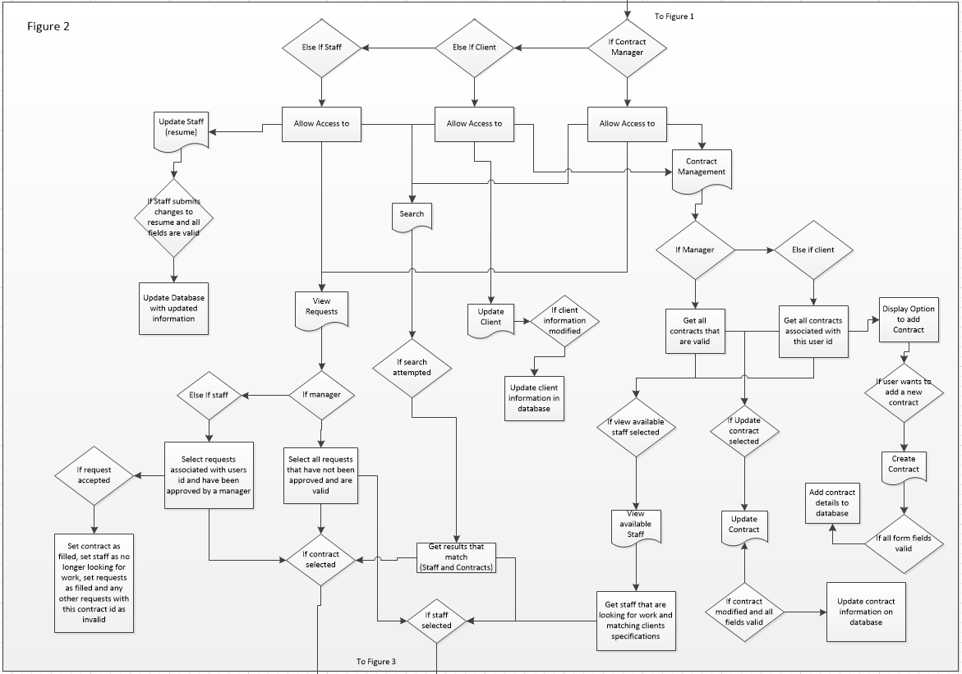
Requirements & Analysis Overview
Process Flow Continued
Speaker: Rachel Spiegelhoff

Slide 12
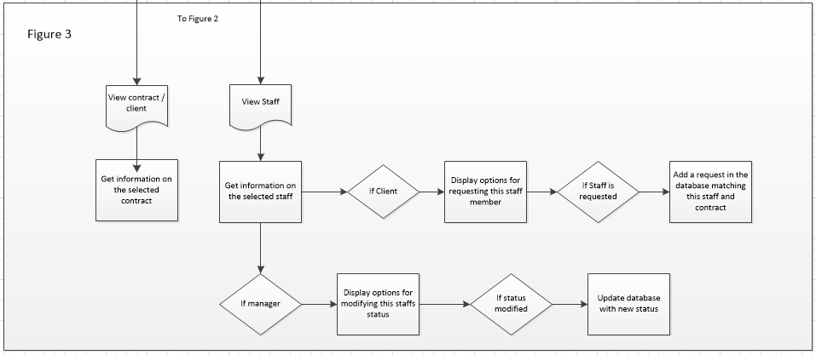
Requirements & Analysis Overview
Process Flow Continued
Speaker: Rachel Spiegelhoff

Slide 13
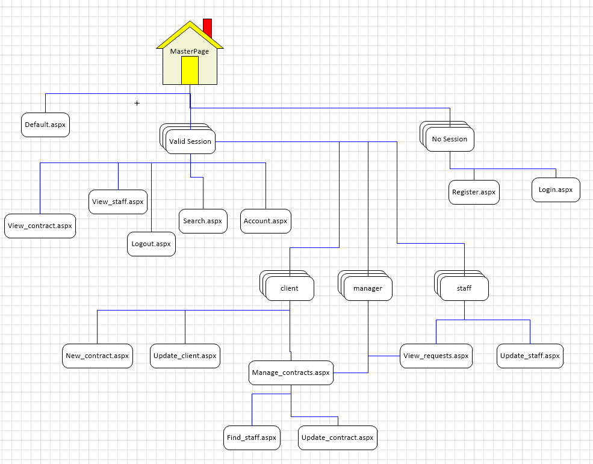
Design Overview
Speaker: Rachel Spiegelhoff

Slide 14

Construct Overview
Project Development Process
Weekly team meeting to discuss weekly assignment
Assignments broken down by section
Team member selection of sections
Review
Combine
Website development
Three parts of the website created and tested
Documentation overview to verify process flows
Speaker: Taunyl Bailey

Slide 15
Construct Overview
Project Development Tools
Domain host – Godaddy.com
Utilized Microsoft Visual Studio and ASP.net to create website
C++ programming language
Microsoft products used to create documentation
Visio
Word
Excel
Database created using SQL server available over the internet to all team members
FTP site used to share website pages and directly upload web content available
Passwords for each team member
Speaker: Taunyl Bailey

Slide 16
Construct Overview
Standards
Followed APA style rules for font and text size
Common programming language
Used same software programs for web site development
Application must function in a logical manner
Application must be easy to use for non-members
Quality checks by each team member
Web application support for standard browsers and operating systems
Speaker: Taunyl Bailey

Slide 17

Application Demonstration
Speaker: Jeremy Adams

Slide 18
Lessons Learned
Work Schedules – Team C learned to cope with different sorts of work schedules and time zone constraints throughout the virtual team environment by maintaining constant communication through the portal discussion and e-mails. The Sunday meetings helped in the aspect of allowing members to receive the information that they needed to complete their assignments, and the information for the team members who did not attend, to be able to review the weekly meeting at a time that was convenient for them.
Speaker: Tim Olson

Slide 19
Lessons Learned
Communication Skills – Through the last seven weeks, team C has effectively communicated with each other through the use of e-mails, text messages, team meetings, and mainly the discussion forums in the student portal.
Time – Time was of the essence within the last seven weeks. Team C pulled together in regards to completing all their tasks on time and fulfilling all personal obligations within the required time frame constraint.

Slide 20

Questions

